Slide 1
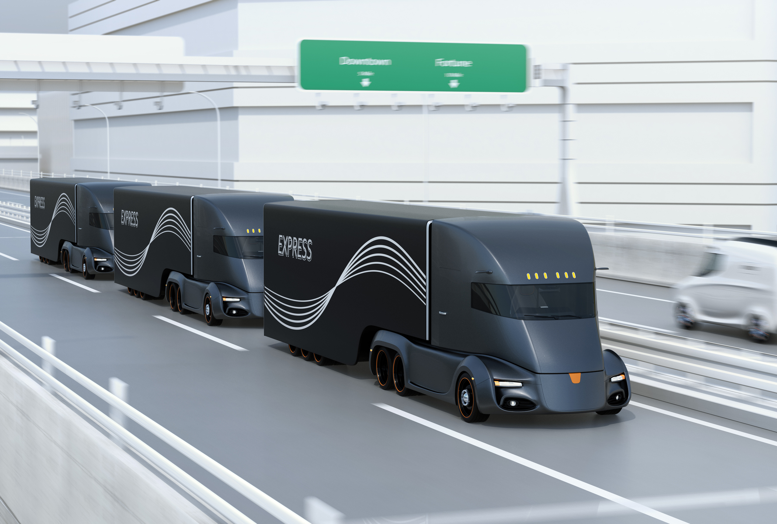
Truck platooning

Slide 2
The characteristics in trucks platooning
Reactive systems
The trucks keep detecting whether there are objects in the front or not. If the trucks detected objects, they will behave differently based on different objects.
Real-time systems
In truck platooning, for example, the system can suddenly brake.
Continuous systems
The trucks can increase or decrease the speed. But the speed will be continuously increasing or decreasing.

Slide 3
The characteristics in trucks platooning
Dependable systems
Because the truck platooning can save costs and improve the road safety, more and more companies now are applying this technique to their own products. Also, truck platooning is co-funded by the EU, which means is supported by the government.
Distributed systems
While the trucks are driving, the trucks can still do other things such searching for the parking spaces, opening gap or closing gap at the same time.

Slide 4
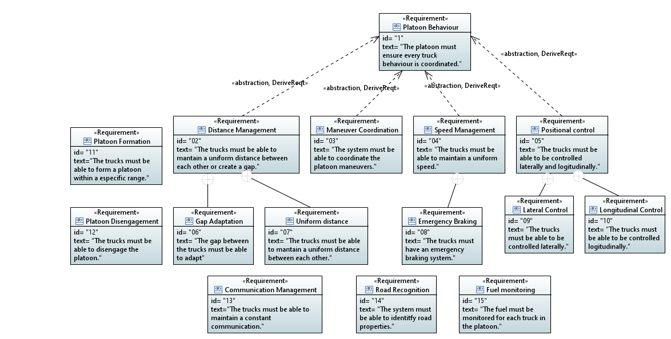
Specification of the analysis model Requirements diagram

Slide 5
Refined USE cases
Refine three use cases with activity diagrams
Platoon Formation
Gap Adaptation & Emergency braking using Object Detection
Parking systems

Slide 6
Platoon formation

Slide 7
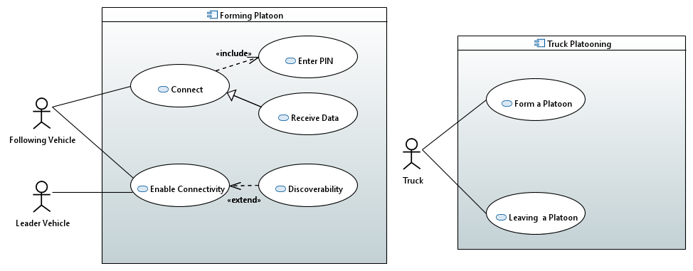
Use case diagram

Slide 8
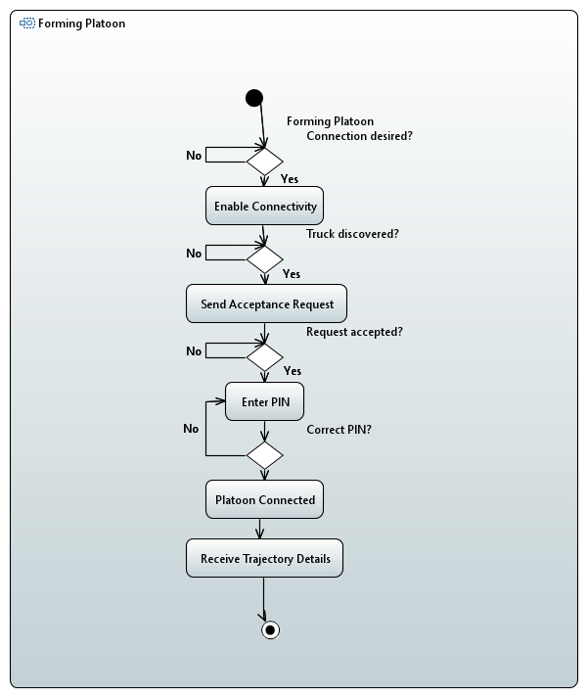
Activity diagram

Slide 9
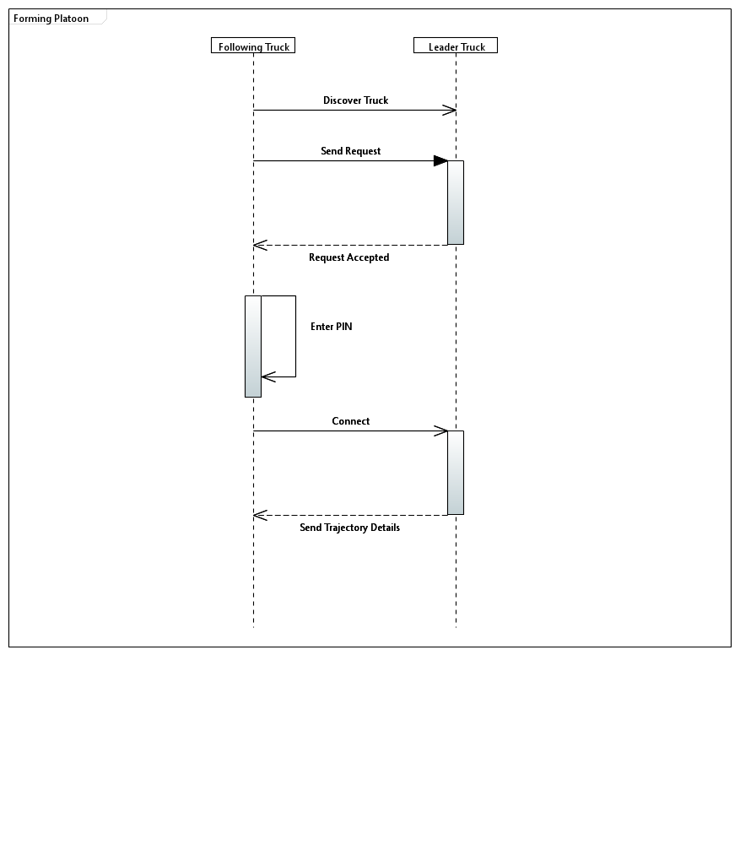
Sequence Diagram ​

Slide 10
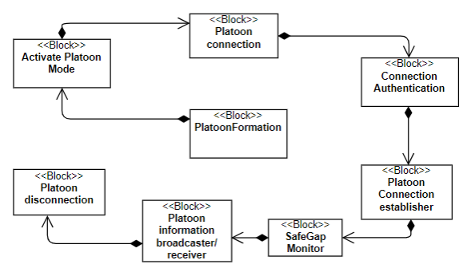
Block Diagram

Slide 11
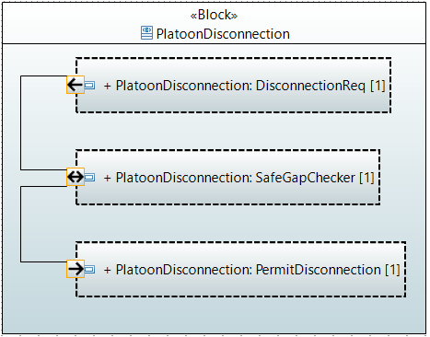
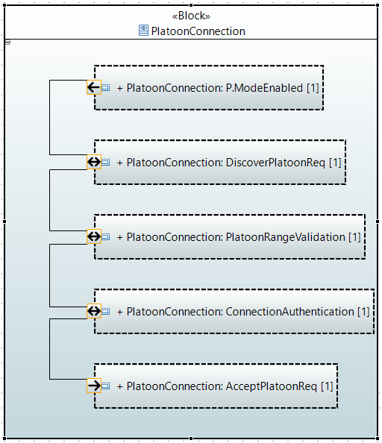
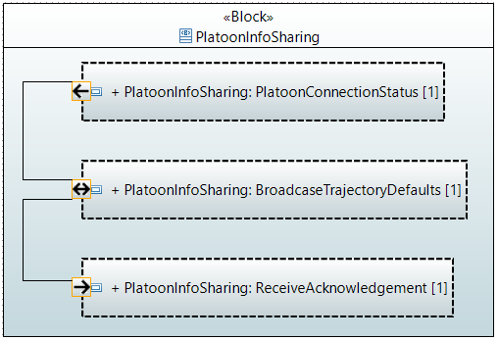
Internal block diagram

Slide 12
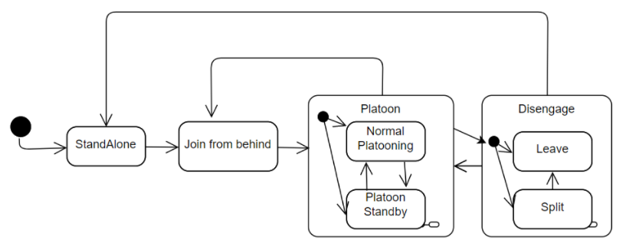
State machine

Slide 13
GAP Adaptation techniques

Slide 14
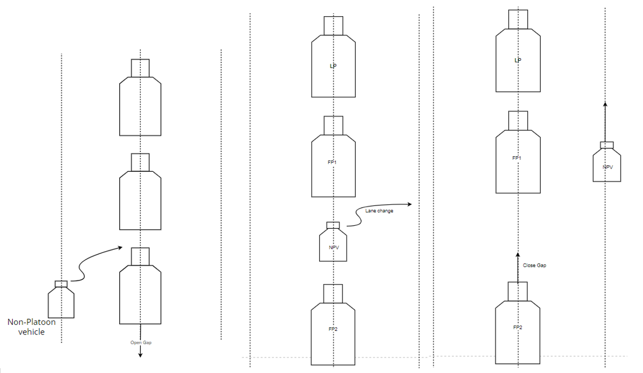
Use case overview

Slide 15
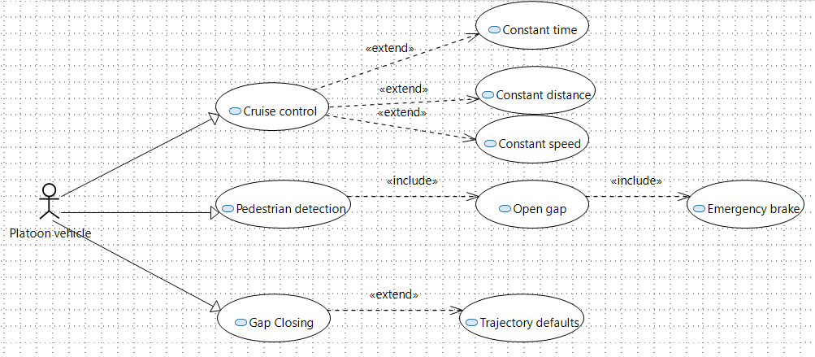
use case Diagram

Slide 16
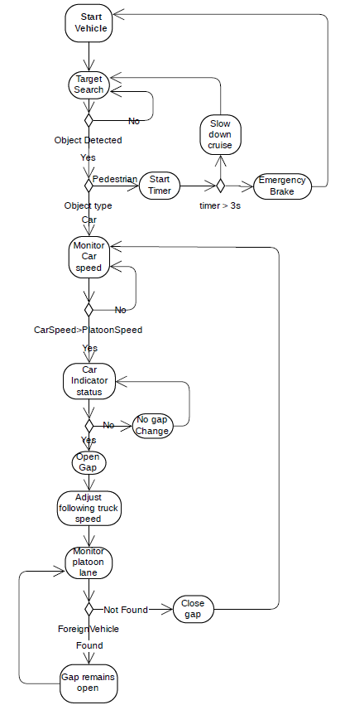
Activity diagram

Slide 17
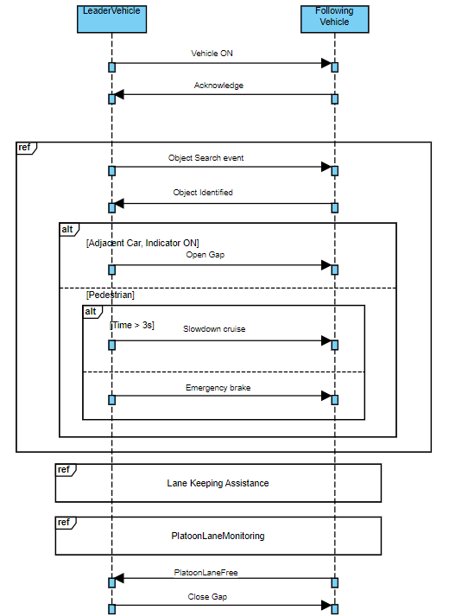
Sequence DIAGRAM

Slide 18
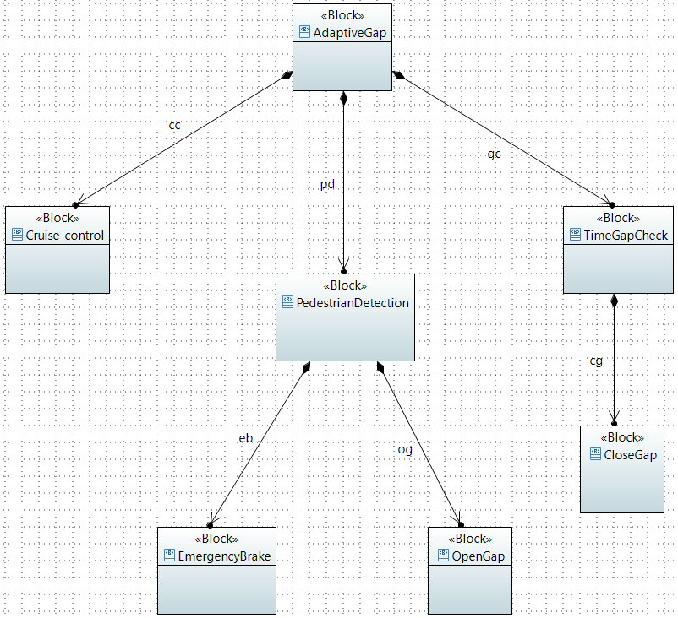
BLOCK DIAGRAM

Slide 19
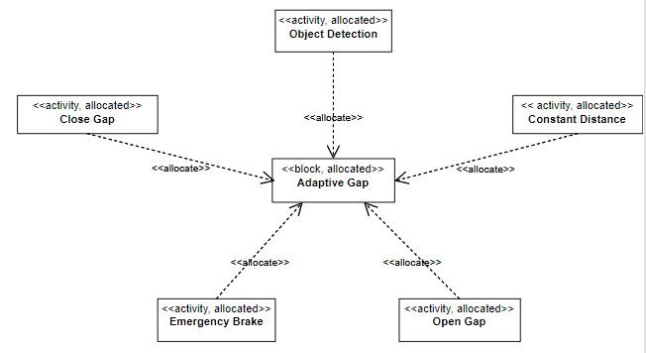
Allocation diagram

Slide 20
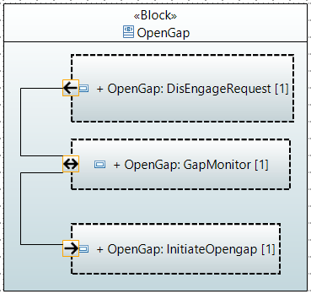
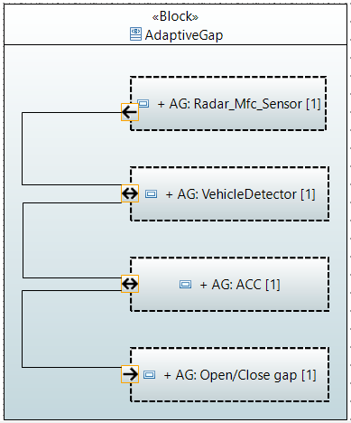
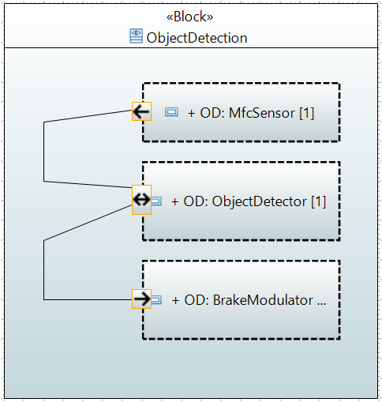
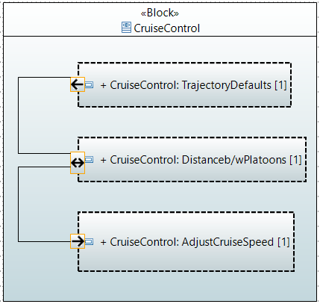
INTERNAL BLOCK DIAGRAM

Slide 21
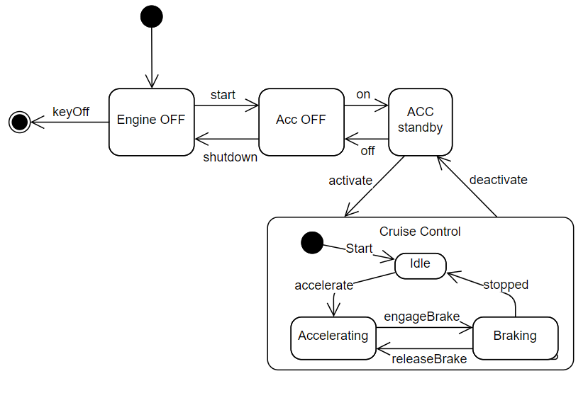
State-MAchine Diagram

Slide 22
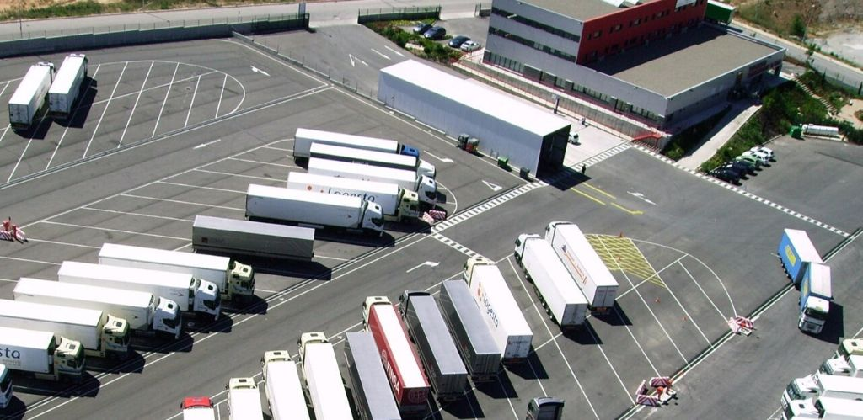
Parking system

Slide 23
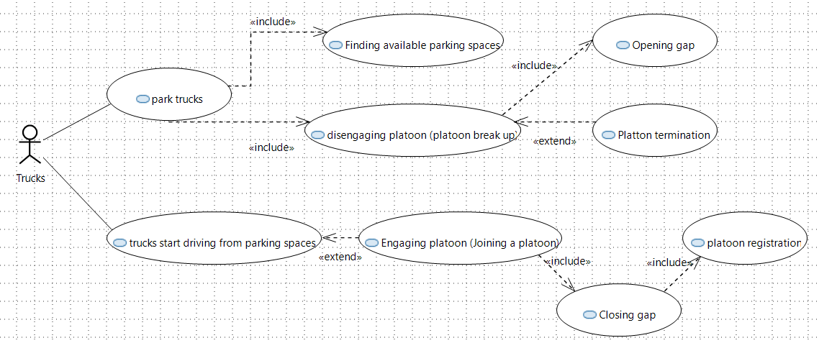
Use cases

Slide 24
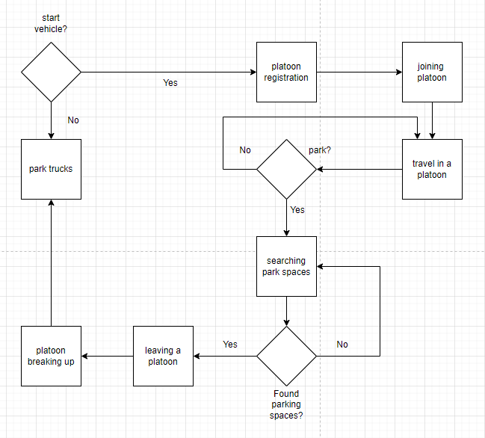
Activity diagram

Slide 25
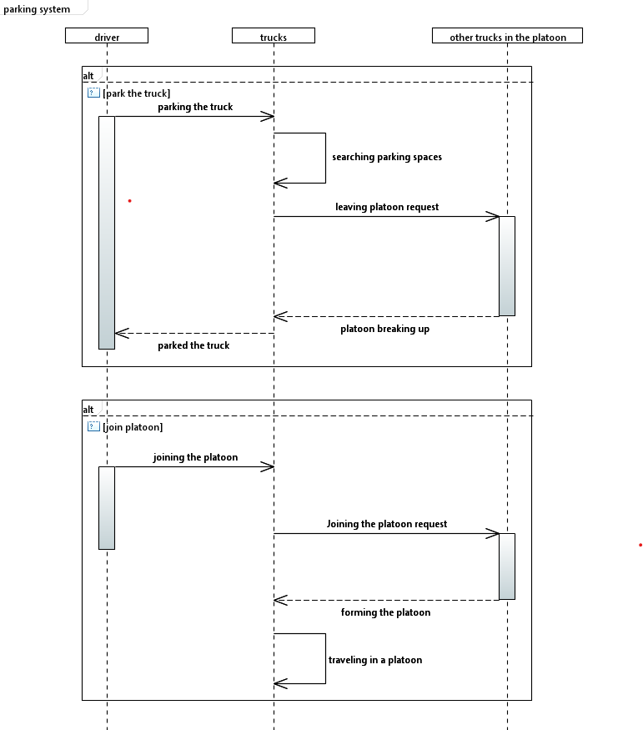
Sequence diagram

Slide 26
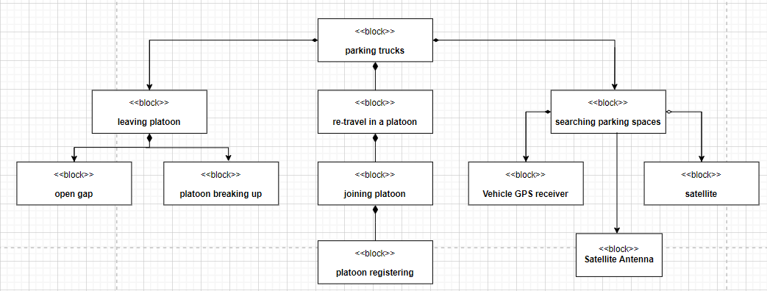
Block diagram

Slide 27
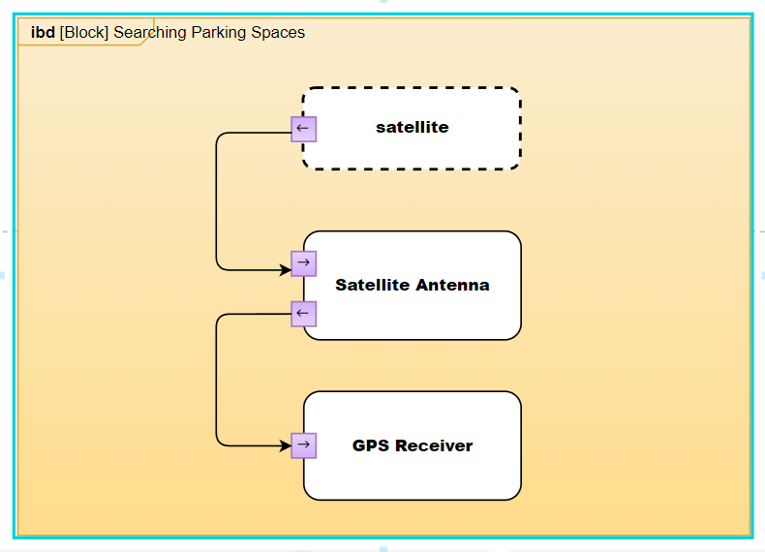
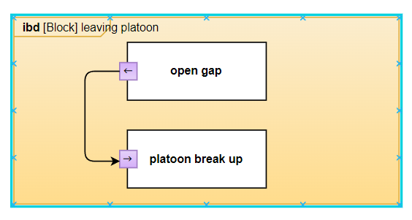
Block diagram with internal block diagrams

Slide 28
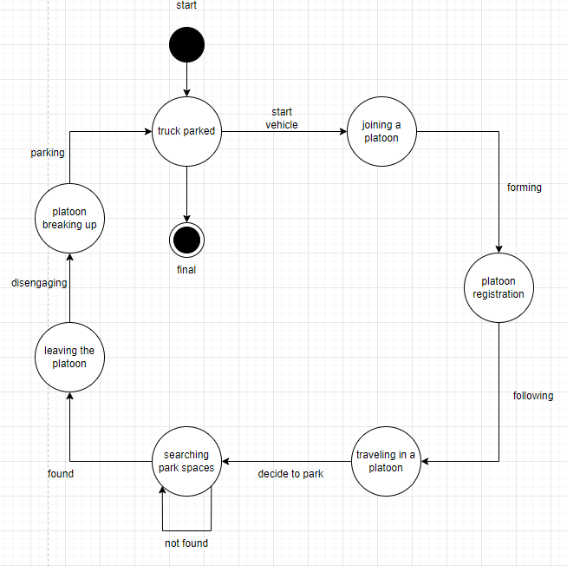
State machine

Slide 29
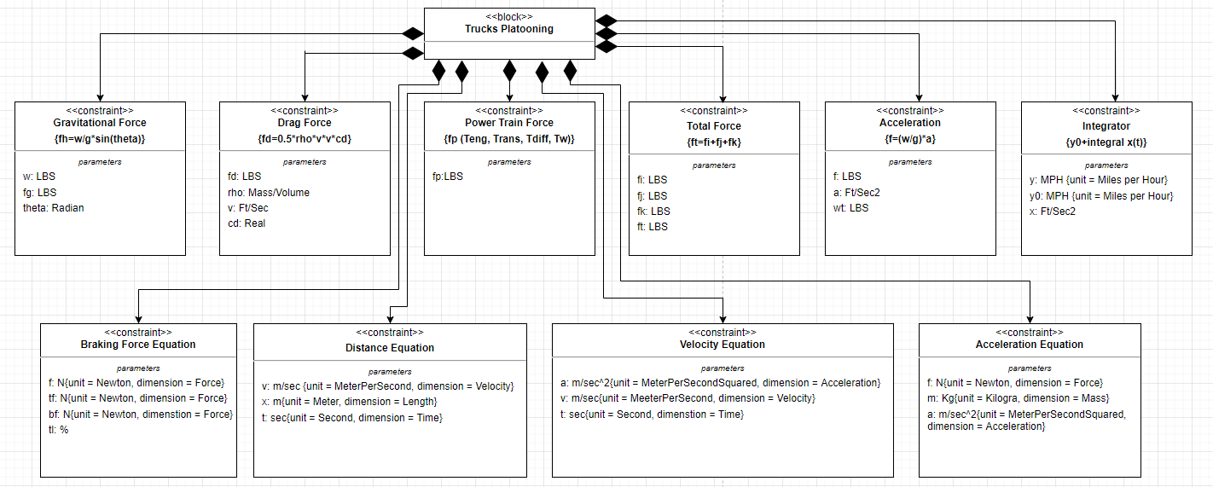
Parametric constraint diagrams block definition diagram

Slide 30
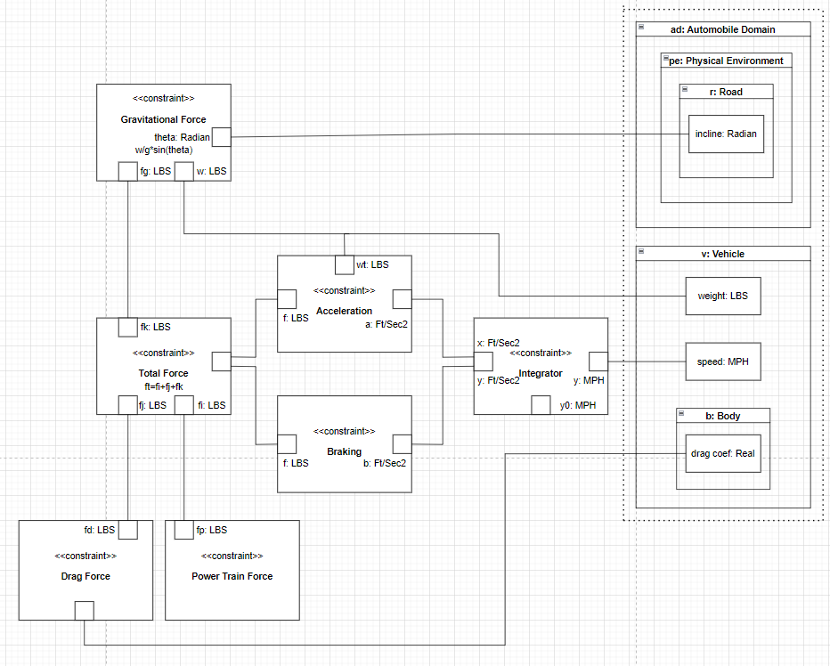
Parametric constraint diagrams

Slide 31
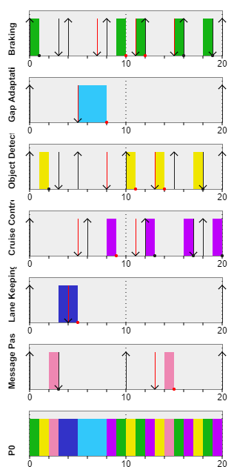
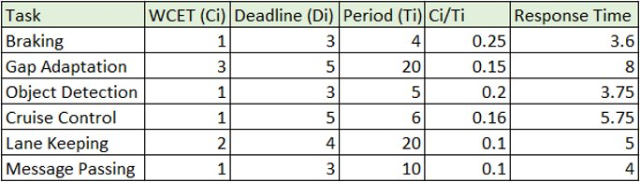
Scheduling
Earliest deadline first principle is used
Periodic and static real time scenario is considered

Slide 32
Hardware implementation

Slide 33
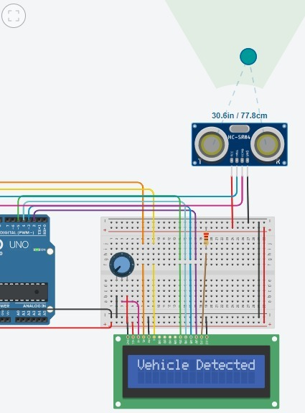
Circuit simulation

Slide 34
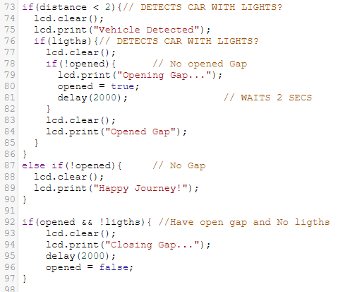
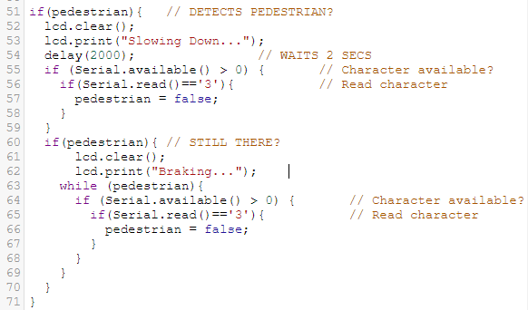
Code for hardware implementation

Slide 35
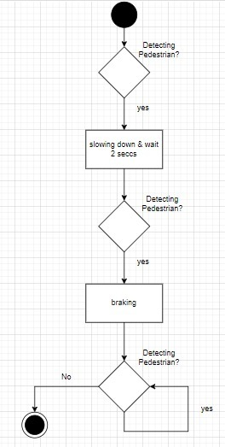
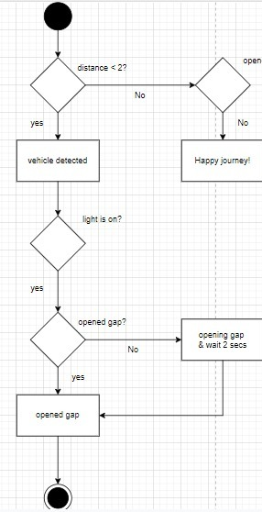
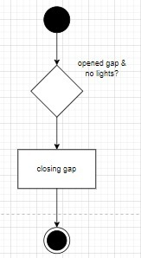
Activity diagrams

Slide 36
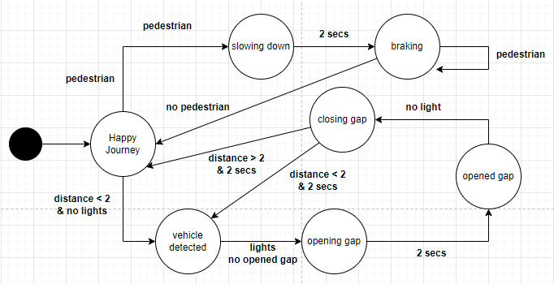
Messages state machine

Slide 37
Junit testing

Slide 38
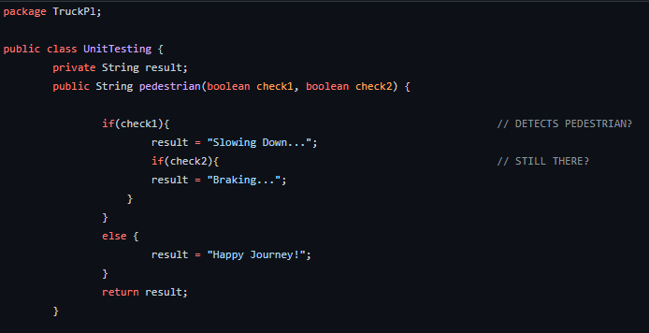
Pedestrian detection

Slide 39
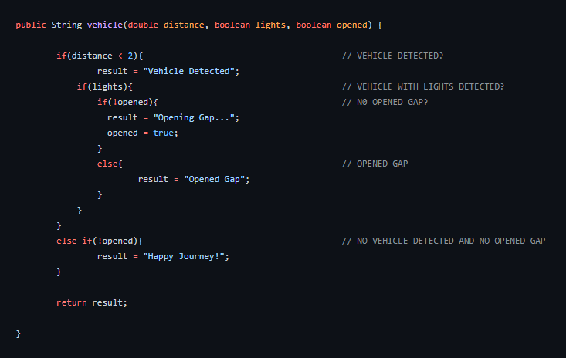
Vehicle and lights detection

Slide 40
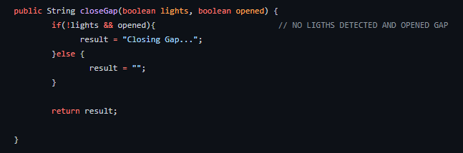
Gap detection

Slide 41
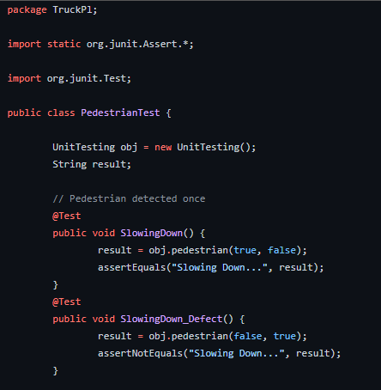
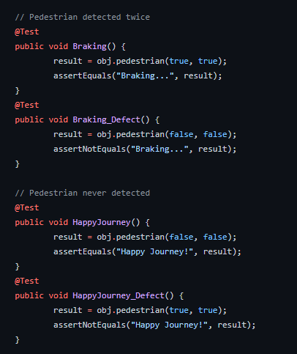
Pedestrian detection tests

Slide 42
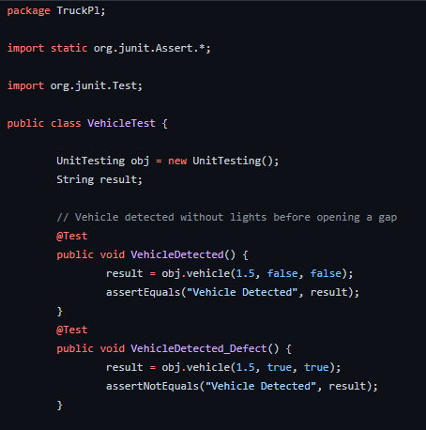
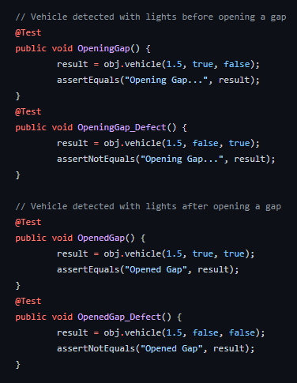
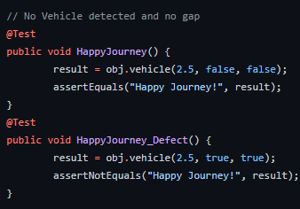
Vehicle and lights detection test

Slide 43
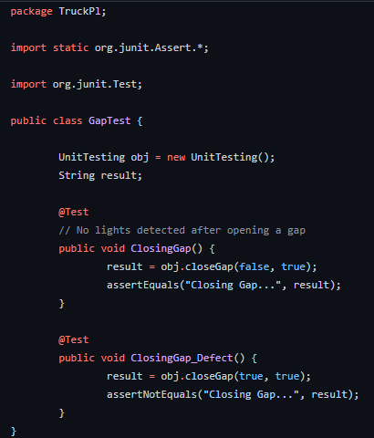
Gap detection Test

Slide 44
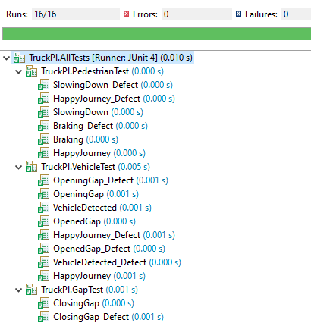
Testing results

